Slide 1

2026-27 EOBA
Preseason Meeting

Slide 2
Agenda
-OVBABO (Referee Board) points of emphasis & rule changes
-Discipline Committee: Review roles & responsibilities + Process
-EOBA: Resources + Helpful tips
-Q&A session

Slide 3

OVBABO
Ottawa Valley Board of Approved Basketball Officials
-Governing body for recognized basketball officials in the Ottawa Valley
-Carded officials must be used for all EOBA games in order for them to be deemed sanctioned by Ontario Basketball
-OVBABO runs from Brockville, to Vankleek Hill, and covers the majority of participating EOBA clubs.
-Examples of clubs who would use non-OVBABO refs would be: Gatineau clubs, Kingston, Belleville, Cornwall, Upper Valley etc.

Slide 4
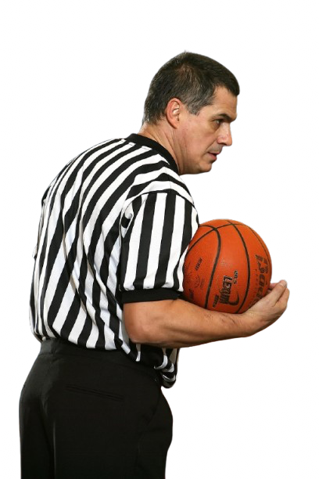
OVBABO Resources
Website:
https://ovbabo.com/
Booking refs for exhibition games:
-Eric Jordan: teamjordan005@aol.com
Want to become a ref?
https://ovbabo.com/about-ovbabo/interested-in-becoming-a-ref/
Provide feedback about refs (good or bad)
https://ovbabo.com/client-reporting-section/

Slide 5
OVBABO Talk
(Refer to recording if you missed the call)

Slide 6
EOBA Discipline Committee
Members:
-Nick Neeley
-Angela Pompeo
-Murray Shoup
Overview & Documents:
https://eobahoops.com/disciplinary-committee
Rulebook:
2026-27 Rules & Regulations

Slide 7
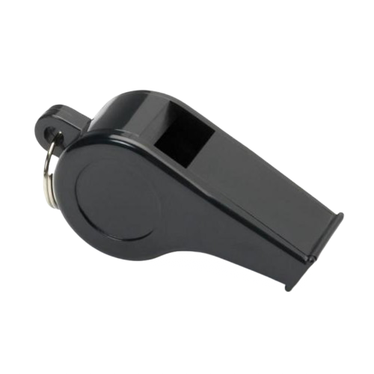
Discipline Committee Continued
Policies are the same as OBA, however they are executed on a local level to improve speed, follow up, and tracking.
Important items to note (please review all responsibilities before the season):
In the event of an incident, or mandatory ejection (ex: receiving 2 technical fouls in 1 game), teams have 24 hours to submit the incident to the disciplinary committee for review. This should be done electronically so there is a timestamp of the submission, and can be submitted via the Incident Report Form (also found under the fair play tab above).
The head coach of the team who was involved in the incident can designate any member of their staff to submit this form on their behalf. However, it is ultimately the head coach's responsibility to ensure the report is submitted in a timely manner.
Reports not submitted within a 24 hour time frame carry an automatic 1 game suspension for the head coach.
Any clubs, teams, or individuals who wish to appeal a decision made by the Eastern Ontario Disciplinary Committee must include:
A signed letter of support for the appeal from the respective club President outlining why they believe the ruling should be reviewed. That letter can be sent electronically here.
A $100 bond, made payable to Eastern Ontario Basketball. That bond can be sent electronically to the league Treasurer, Deb Morris here. Please include "Appeal Bond For..." in the notes section, with reference to the incident in question. Should your appeal be successful, the $100 will be returned to the club. If it is unsuccessful, the bond is forfeited.
Please Note: Any appeal should include additional information, not already presented when the disciplinary committee initially gathered statements from the club/individual in question. If the appeal consists simply of a restatement of the facts already presented, it is highly unlikely to be successful.

Slide 8
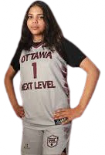
Important Notes For 2026-27 Season
Please familiarize yourself with the competitive section of the website:
https://eobahoops.com/2025-26-competitive-season
Q: After a game is played what do I do with the scores?
A: Submit the results (does not matter if you are the winning or losing team) via Team Snap Tournaments app. You will also want to submit the results to OBA for your Ontario Cup ranking at the end of the year. There is a link to the OBA score submission form at the link above.
Q: I would like my team manager to submit scores for our team, how do I do that?
A: If you would like additional individuals to be granted score entering capabilities, please send an email to info@dynessports.com and include the individual’s full name and email address. We will then send them an invitation to act as a scorer.
Q: I received my schedule, but only 6 games are listed. Don’t we play 12?
A: Yes, any teams who paid the $1600 fee will be scheduled for 12 games, and entry into the end of year championships. After 6 games are played, the competition committee (Chris-OSS, Craig-OSBA, Ratko-ONL) will review results, and if there are teams that need to be moved up a division or down a division (i.e. too strong or too weak), they will be adjusted for the 2nd half of the season. Selects teams only (made up of high performing house league players) have the option to enter at the mid-season point and play 6 games and the championships.

Slide 9
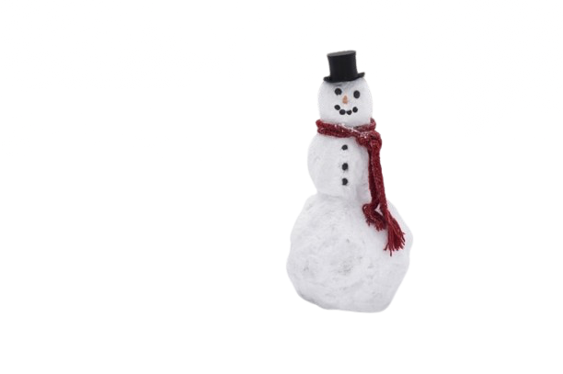
Inclement Weather Policy
-EOBA cannot monitor the road conditions for the entire region. As such teams are required to use their best judgment as to whether they should travel.
i)Be proactive. If there is a massive snowstorm in the near future, contact the other team and discuss whether the game should be rescheduled. You will be given the contact information of every team in your division ahead of time.
ii)A light dusting of snow is not grounds to cancel a game. We live in Canada, not Brazil. There will be snow falls throughout the season.
iii)Be aware of the domino effect of your decisions. If your team elects not to travel for a game, but does not communicate this to anyone, there’s another team, custodians, refs, scorekeepers and more whose time you have just wasted. Unannounced “no-shows” will result in forfeits. Repeat offenders risk being removed from the league without refund.
iv)Best practice is to cancel a game 24-48hrs out. This allows league officials to notify all parties.
v)If a game needs to be rescheduled due to weather, a school issue (ex: burst pipe, custodians slept in etc.) please use a Game Conflict form available under the “resources” tab of the website.

Slide 10

Game Conflict Form
Due to the constraints of OBL, major local tournaments (Chris Paulin, Mike O’Connor etc.), holidays, school closures and more, there are VERY limited weekends available to be able to get in 12 games.
Here are some do’s and don’ts of when to move a game:
-Games should never be moved for extra curricular activities (ex: social events, conflicts with a team outing, signed up for a last second tournament etc.)
-Games against “out of town” teams (ex: Kingston, Belleville etc.)should only ever be moved in the rarest of occasions. There could be hotel implications, sunk costs, and likely other teams (ex: tri-meet) affected by that decision.
Reasons to move a game:
-A mutually agreed upon inclement weather situation
-Loss of permit (ex: school informs you last second that your permit has been cancelled)
-Referee shortage
-Player safety reasons (ex: only 5 healthy players available due to illness, injuries etc.)
***Please note, missing your star player but having 11 other healthy bodies is NOT grounds to move a game. Use common sense.
If a game does need to be moved, please submit a game conflict form as far out as possible. If it is two local teams (ex: WOBA vs. ONL), please consider choosing a weeknight for the make up game as referee resources are stretched thin as it is on weekends.

Slide 11
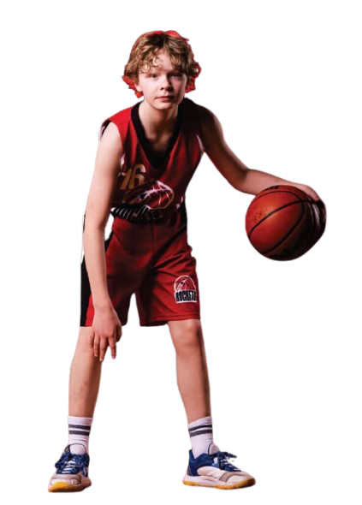
Other Helpful Resources
You can find a ton of helpful resources at eobahoops.com
This includes:
-Game Conflict Form
-Rules
-Disciplinary Roles & Responsibilities
-Printable Scoresheets
-Events Calendar
-Concussion Resources
…and more
Not able to find what you’re looking for?
Use our contact form and we will triage your question and refer it to the appropriate person.

Slide 12
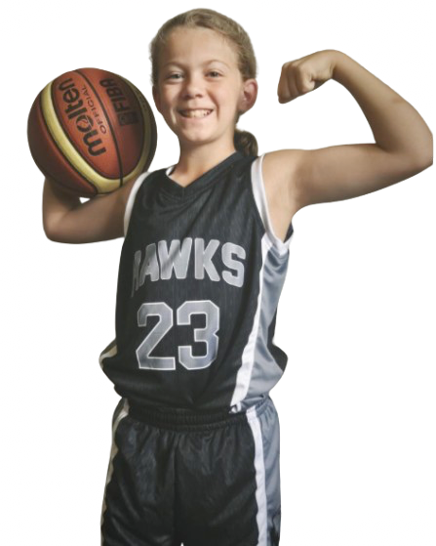
Questions?
Open forum

